Slide 1
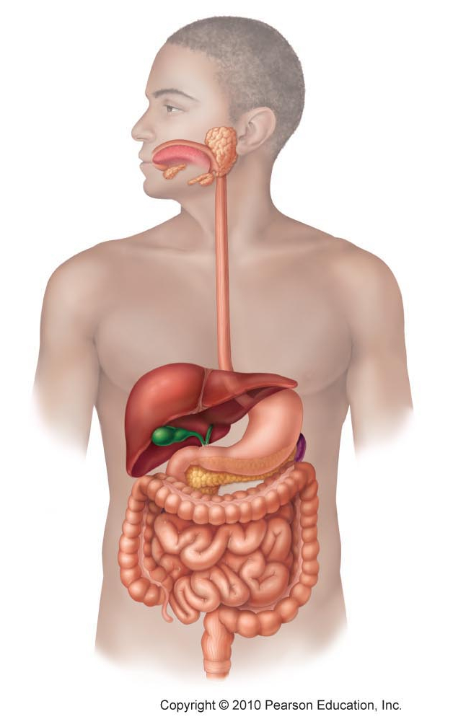
Daily Review
The Organs of the Digestive System
Match each organ to the correct letter in the diagram.
Liver, Mouth, Small intestine, Rectum, Oesophagus, Pancreas, Gall bladder, Anus, Stomach, Large intestine
A
B
C
D
G
H
E
F
I
J
Vocabulary
Faeces: poo

Slide 2
Daily Review
Nutrient absorption in the small intestine
In the small intestine, there are microscopic, finger-like structures called villi.
Think, pair, share: How do the villi help the digestive process?
Think, pair share: What would happen if you did not have villi in your small intestine?

Slide 3
Daily Review
Chemical Digestion - Bile
Chemical digestion is breaking down the chemicals in food and drink using enzymes.
Think, pair, share: Which organ produces bile and where is it stored?
Think, pair share: What type of food does bile break down?

Slide 4
Comparing Digestive Systems

Slide 5
Learning Objectives
CFU
What are we going to learn?
Compare the type and function of teeth in different animals.
Compare the digestive tract of different animals.
Activate Prior Knowledge
Multiple organs make up the digestive tract of humans.
Think, Pair, Share: How many organs in the digestive tract can you name?
Think, Pair, Share: How is the digestive tract different to the digestive system?

Slide 6
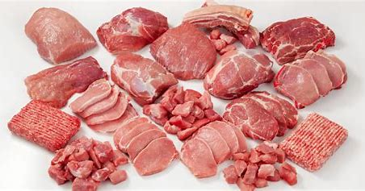
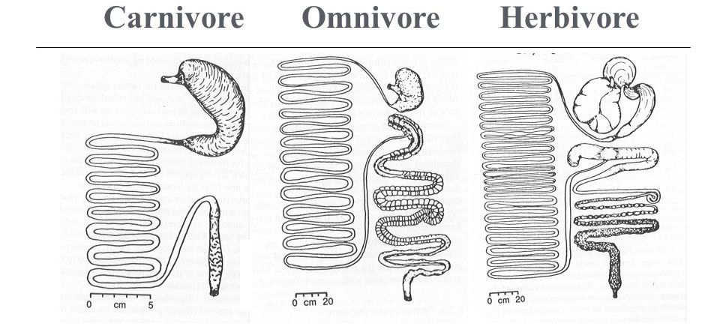
Concept Development
CFU 1
What makes up a carnivore’s diet?
Using Digestive Tract Length to Predict Diet
Carnivores eat meat, which is made of protein.
Proteins are easy to digest.
This means the digestive tracts of carnivores are short because protein is digested quickly.
CFU 2
True or False: Proteins are hard for the body to digest.
CFU 3
Why are carnivore digestive tracts short?
Vocabulary
Herbivores: eat plants Carnivores: eat meat Omnivores: eat meat and plants

Slide 7
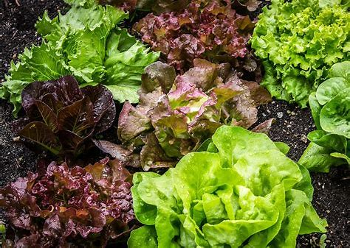
Concept Development
CFU 1
What make up a herbivore’s diet?
Using Digestive Tract to Predict Diet
Herbivores and omnivores eat plants as part of their diet.
Plant cells have cell walls made of cellulose, which is hard to digest.
This means the digestive tracts of herbivores and omnivores are long because it takes longer to break down their food.
CFU 2
Explain why plants are harder to digest.
CFU 3
What effect does cellulose in the diet have on the length of a digestive tract?
Vocabulary
Herbivores: eat plants Carnivores: eat meat Omnivores: eat meat and plants

Slide 8
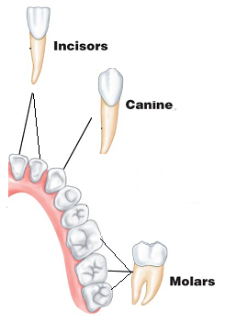
Concept Development
CFU 1
What are the three types of teeth?
Types of Teeth
There are different types of teeth, each with a particular function:
Incisors have a sharp edge and are used to cut through food.
Canines are pointed and used for ripping lumps of meat.
Molars are flat and are used for grinding.
CFU 2
How are molars different to incisors and canines?
CFU 3
How are canines and incisors similar?

Slide 9
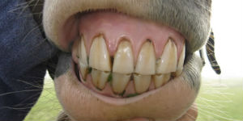
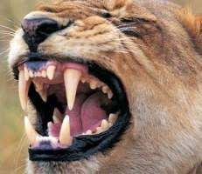
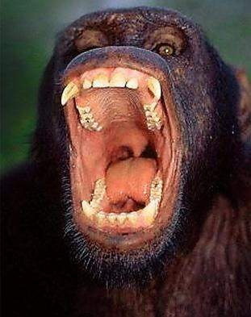
Concept Development
CFU 1
How are the diets of carnivores and herbivores different?
Using Teeth to Predict Diet
Herbivores have flat molars to grind their food so it can be digested more effectively by enzymes.
Carnivores have mostly incisors and canines to cut and tear meat.
Omnivores have a combination of all types of teeth, some for cutting and some for grinding.
CFU 2
Why do omnivores have three types of teeth?
CFU 3
A cow is a herbivore. What type of teeth would you expect it to have?
Vocabulary
Herbivores: eat plants Carnivores: eat meat Omnivores: eat meat and plants

Slide 10
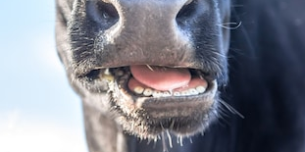
Skill Development/Guided Practice
CFU 1
Are the teeth flat?
Identifying diet using teeth
1. All or most of the teeth are flat = herbivore 2. All or most of the teeth are sharp/pointy = carnivore 3. Teeth are a mixture of flat and sharp/pointy = omnivore
CFU 2
Are the teeth sharp/pointy?
CFU 3
Are the teeth a mixture of types?
What type of diet does this animal have? Explain your choice.
Vocabulary
Herbivores: eat plants Carnivores: eat meat Omnivores: eat meat and plants
This animal is a herbivore because it has flat teeth used for grinding.

Slide 11
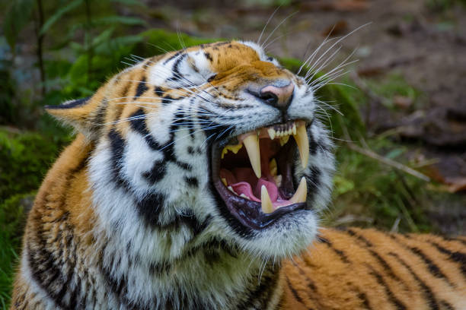
Skill Development/Guided Practice
CFU 1
Are the teeth flat?
Identifying diet using teeth
1. All or most of the teeth are flat = herbivore 2. All or most of the teeth are sharp/pointy = carnivore 3. Teeth are a mixture of flat and sharp/pointy = omnivore
CFU 2
Are the teeth sharp/pointy?
CFU 3
Are the teeth a mixture of types?
What type of diet does this animal have? Explain your choice.
Vocabulary
Herbivores: eat plants Carnivores: eat meat Omnivores: eat meat and plants
This animal is a carnivore because it has sharp and pointy teeth used for tearing meat.

Slide 12
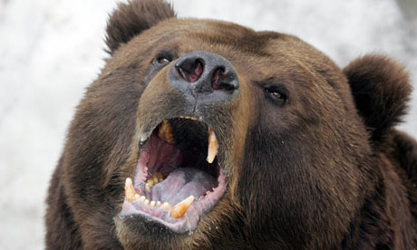
Skill Development/Guided Practice
Vocabulary
Herbivores: eat plants Carnivores: eat meat Omnivores: eat meat and plants
CFU 1
Are the teeth flat?
Identifying diet using teeth
1. All or most of the teeth are flat = herbivore 2. All or most of the teeth are sharp/pointy = carnivore 3. Teeth are a mixture of flat and sharp/pointy = omnivore
CFU 2
Are the teeth sharp/pointy?
CFU 3
Are the teeth a mixture of types?
What type of diet does this animal have? Explain your choice.
This animal is an omnivore because it has a mixture of flat and pointy teeth used for grinding plants and tearing meat.

Slide 13
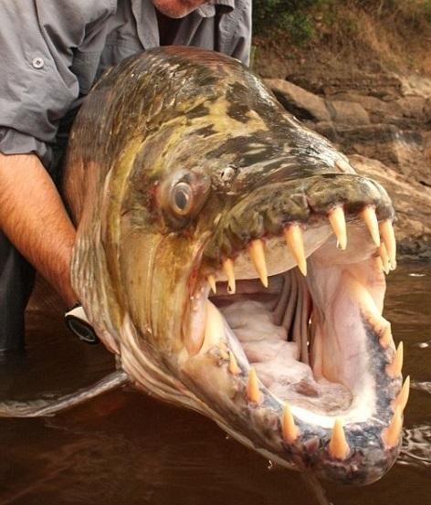
Skill Development/Guided Practice
CFU 1
Are the teeth flat?
Identifying diet using teeth
1. All or most of the teeth are flat = herbivore 2. All or most of the teeth are sharp/pointy = carnivore 3. Teeth are a mixture of flat and sharp/pointy = omnivore
CFU 2
Are the teeth sharp/pointy?
CFU 3
Are the teeth a mixture of types?
What type of diet does this animal have? Explain your choice.
Vocabulary
Herbivores: eat plants Carnivores: eat meat Omnivores: eat meat and plants

Slide 14
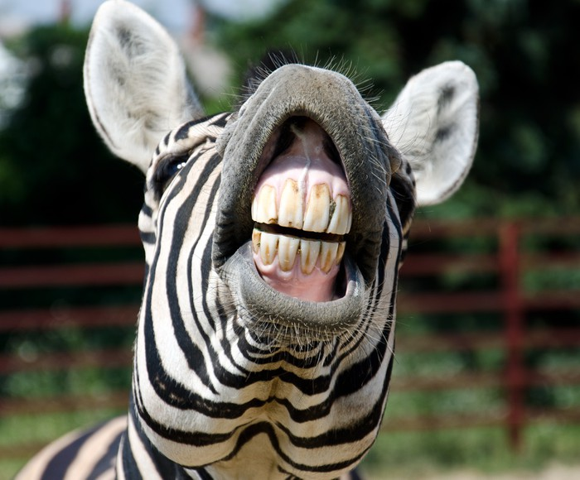
Skill Development/Guided Practice
CFU 1
Are the teeth flat?
Identifying diet using teeth
1. All or most of the teeth are flat = herbivore 2. All or most of the teeth are sharp/pointy = carnivore 3. Teeth are a mixture of flat and sharp/pointy = omnivore
CFU 2
Are the teeth sharp/pointy?
CFU 3
Are the teeth a mixture of types?
What type of diet does this animal have? Explain your choice.
Vocabulary
Herbivores: eat plants Carnivores: eat meat Omnivores: eat meat and plants

Slide 15
Relevance
Knowing how organs work together in a system and how the systems interact with each other will help you understand how the body works.
Understanding the structure and function of the digestive system will help you understand how we get out energy and nutrition.
Understanding the differences between organ systems in different types of organisms will help you understand how the structure of organs affects their function.

Slide 16
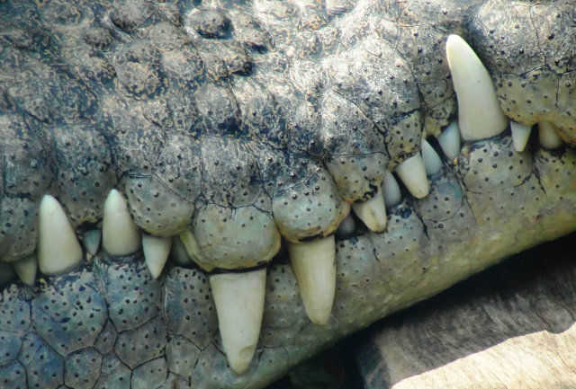
Skill Closure
How does the length of the digestive tract of a herbivore compare to that of a carnivore?
Skill Closure
There are three types of teeth - molars, incisors and canines. How is the function of a molar different to incisors and canines?
Skill Closure
Are these teeth from a herbivore or a carnivore? Explain your choice.

Slide 17
Independent Practice
Collect and complete a hard copy of the Different Digestive Systems worksheet or download it from Connect.

